Slide 1
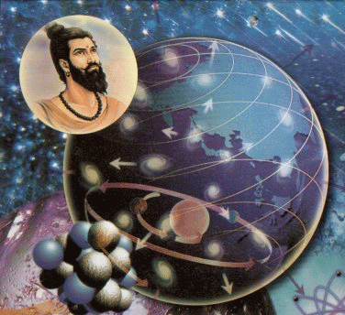
Kanad
Hindu sage
600 BC
Atomism
All matter was composed of nine elements: earth; water; light; wind; ether; time; space; mind and soul

Slide 2
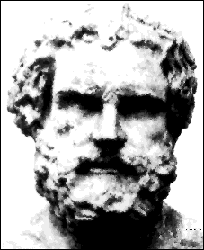
Democritus
Greek philosopher
400 BC (same time as Plato, Hippocrates,
& Socrates, just before Aristotle)
Atomos = “indivisible”
Rock divided had same properties as original rock
“atomos” were specific to the material that they made up.

Slide 3
Al-Ghazali
Islamic Philosopher
1100
May be particles smaller than atoms
Atoms are eternal & material

Slide 4
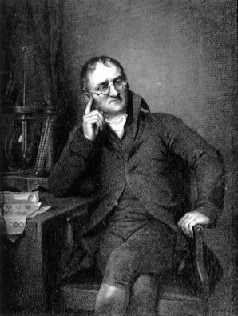
John Dalton
English Scientist
1800 (before Mendeleev)
Dalton’s Model:
Atoms were like tiny, hard spheres
Each element had its own atoms
Atoms could not be split

Slide 5
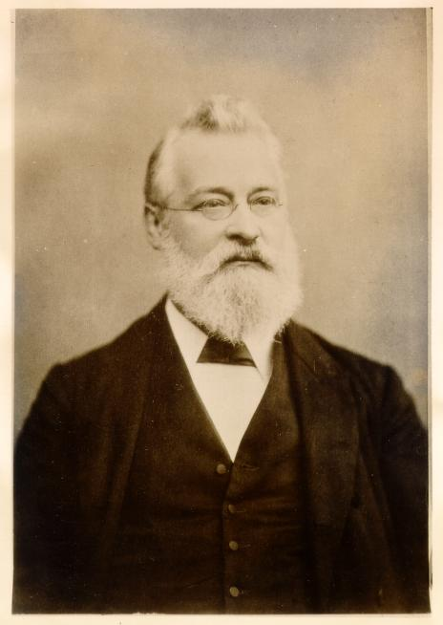
John Newlands
British Chemist
1863
Proposed “Law of Octaves” – properties of elements repeated by sets of 8

Slide 6
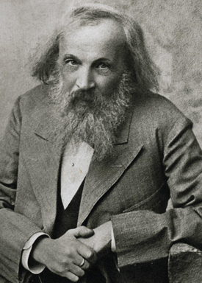
Dmitrii Mendeleev
Father of Modern
Periodic Table
Russian Chemist
Worked for Russian Weights & Measures
Also worked on the liquefaction of gases & on a theory of solutions
1834-1907

Slide 7
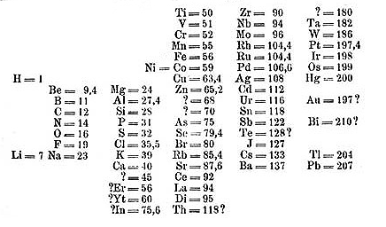
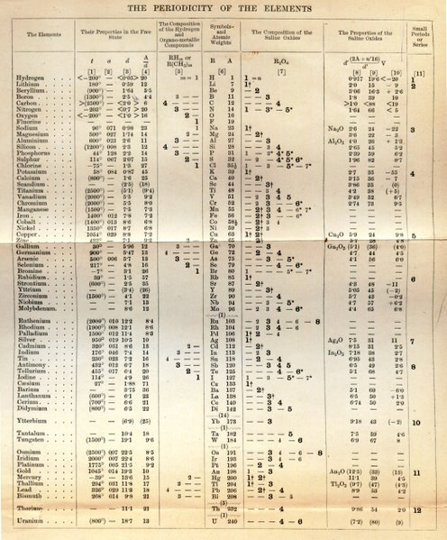
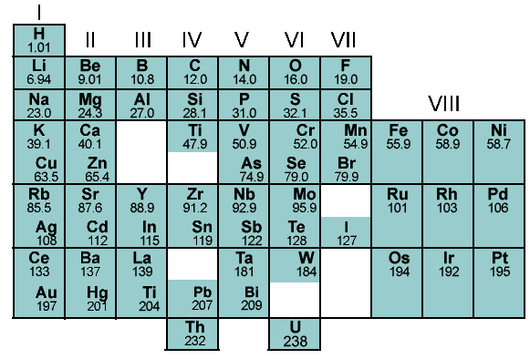
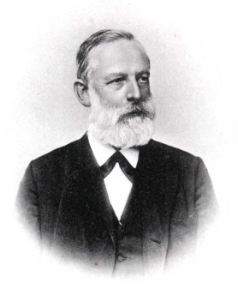
In 1869, Dmitri Mendeleev published his version of the periodic table.
Beat Meyer by 1 year!
http://www.chemheritage.org/pubs/ch-v25n1-articles/feature_mendeleev.html

Slide 8
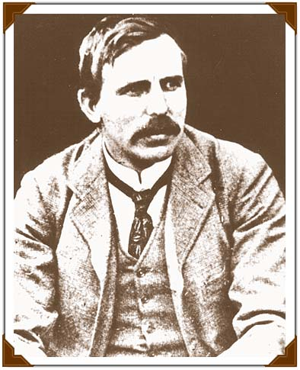
JJ Thomson
British Scientist
1897 (after Mendeleev)
1st to discover the Electron
Atom made of smaller particles
Atom has positive charge
Negative electrons are embedded in it
Plum Pudding Model (like chocolate
chip muffin)
Cathode ray tube experiment

Slide 9
Hantaro Nagaoka
Japanese Scientist
1904
1st Saturian model of atom

Slide 10
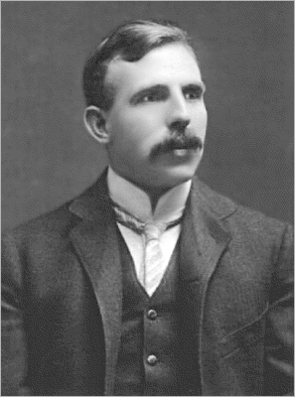
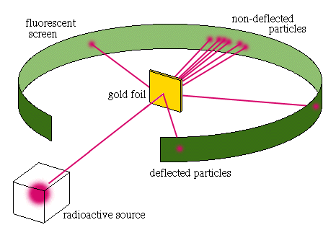
Ernest Rutherford
British Scientist
1911
1st direct probe of the atom
Named the positive center Nucleus
Atom mostly empty space
Electrons surround nucleus
Gold foil experiment

Slide 11
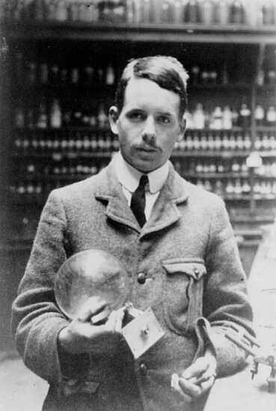
Henry Moseley
1913, Henry Moseley discovered the atomic numbers of elements.
Atomic Number = # of Protons (p⁺)

Slide 12
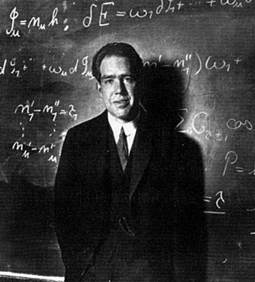
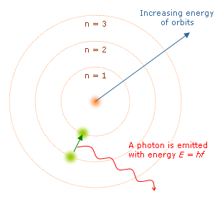
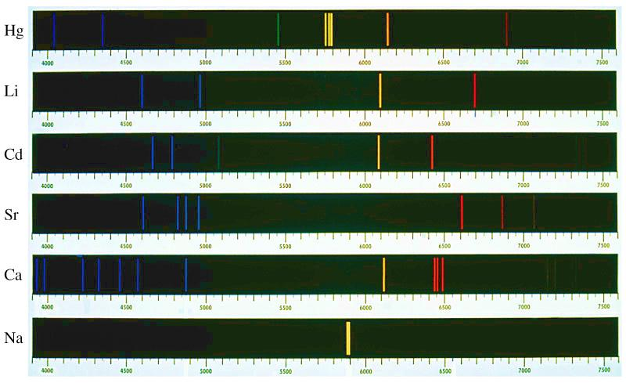
Niels Bohr
Danish Scientist (2nd only to Einstein)
1913
Electrons move in specific orbits
Atoms give off or take in energy when electrons change orbitals

Slide 13
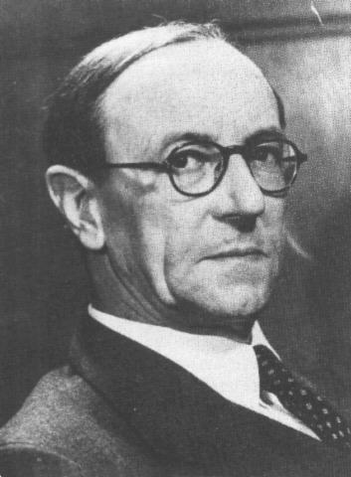
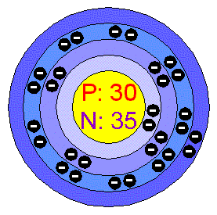
James Chadwick
British Scientist
1932
Proved the existence of Neutron

Slide 14
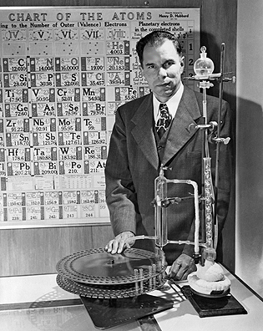
Glenn Seaborg
American Scientist
1940 Discovered Plutonium
Discovered all the transuranic elements from 94 to 102.
Reconfigured the periodic table with the actinide series and lanthanide series below periodic table.
1951 Nobel Prize

Slide 15
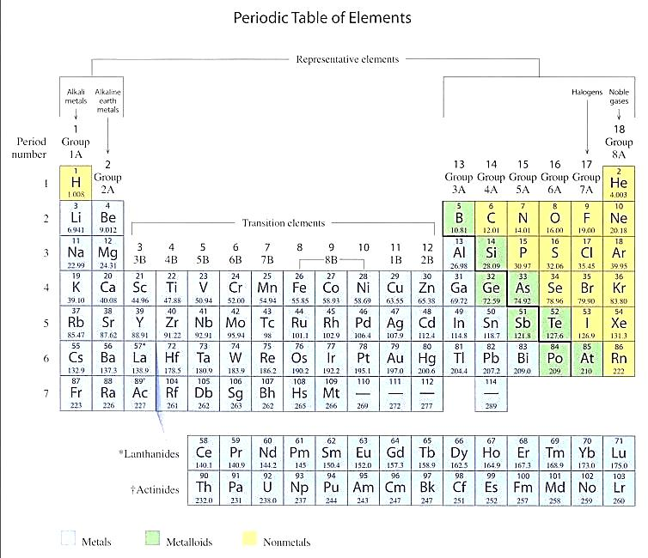
Modern

