Slide 1
PHYSICS and math
OF SOUND

Slide 2

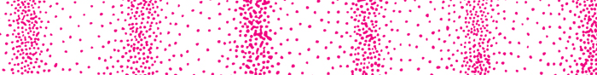

Stationary sound source

Slide 3
DOPPLER EFFECT
http://video.google.com/videosearch?q=doppler+effect&hl=en&emb=0&aq=f#
Doppler Effect = change in pitch or frequency due to moving sound source or receiver

Slide 4

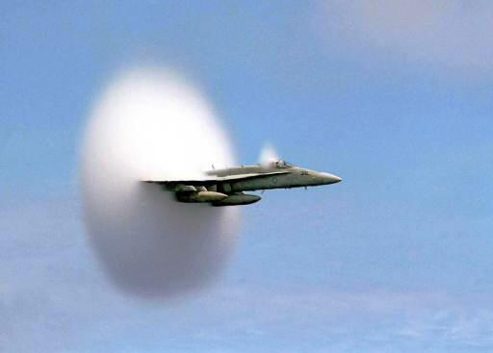
Super Sonic & Breaking the Sound Barrier
Sonic boom is a noise similar to thunder caused by an object moving at supersonic speeds, faster than sound, about 750 mph.

Slide 5
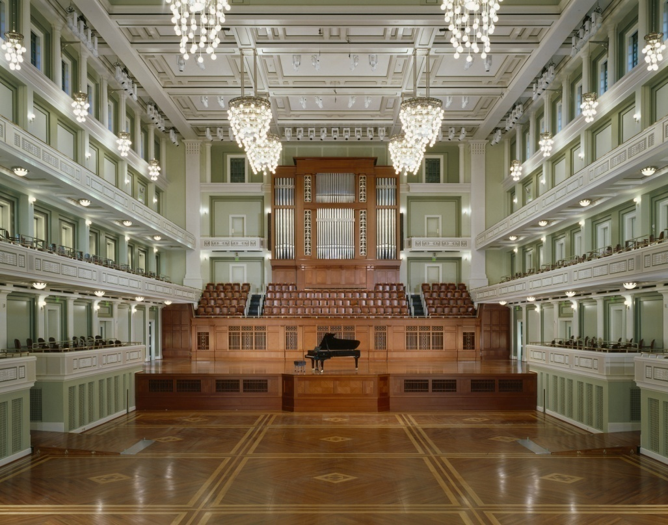
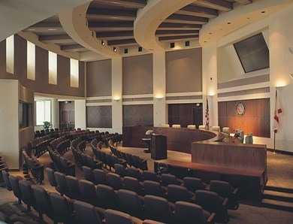
Any elastic material can transmit sound.
Echoes are reflections from smooth, hard surfaces.
Echo free rooms sound “dead.”

Slide 6
Calculating the speed of a wave
(remember → speed is distance over time)
V = λ f
m/s
m
Hz
1/s

Slide 7
V = λ f
A wave has a frequency of 4.05 hertz and a wavelength of 4.00m. What is the wave’s speed?
f =4.05Hz λ = 4.00m
V = λ f
v = (4.00m)(4.05Hz)
v = 16.2 m/s

Slide 8
V = λ f
= V
f
f= V
λ

