Slide 1
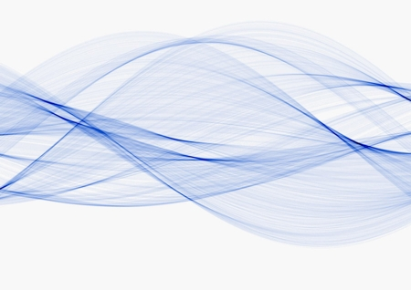
Waves

Slide 2
Types of Waves
Mechanical waves = require a medium to travel
(air, water, ropes, etc)
Transverse waves
Longitudinal waves
Electromagnetic waves = do NOT require a medium
(light, radio waves, microwaves, etc)

Slide 3
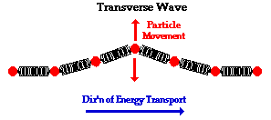
Transverse Waves
Cause medium to move perpendicular (90º) to direction of wave

Slide 4
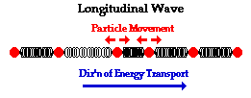
Longitudinal Wave
Cause medium to move parallel to direction of wave
Sound waves are longitudinal

Slide 5
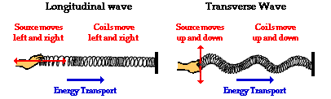
Comparing Waves

Slide 6
Electromagnetic Waves
Do NOT require a medium
Can transmit energy in a vacuum (empty space)
vibration of charged particles

Slide 7
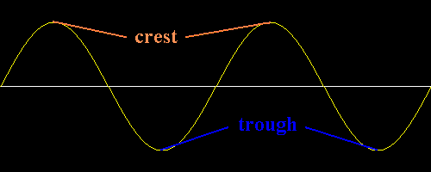
Crests and Troughs
Crest = Highest point of a sound wave on graph
Trough = Lowest point of a sound wave on graph

Slide 8
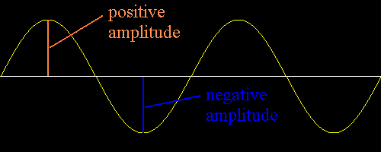
Amplitude
Maximum movement of a sound wave from rest.

Slide 9
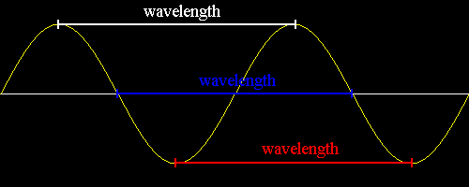
Wavelength (λ)
distance between any two consecutive locations on the wave.
crest to next crest
trough to next trough
start of wave cycle to next starting point

Slide 10
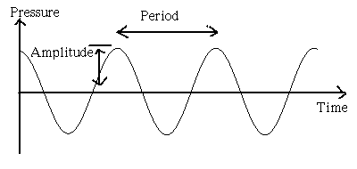
Horizontal Axis: time in seconds
Vertical Axis: molecular movement
Crest: higher pressure
Trough: lower pressure
Amplitude: height of wave; intensity
Compression
Rarefaction
Crest
Trough

Slide 11
Frequency (f )
Number of complete waves (or cycles)
how many waves per second
1 Hertz (Hz) = 1 cycle/second
If ten waves are made per second, then the frequency (f ) = 10 Hz

Slide 12
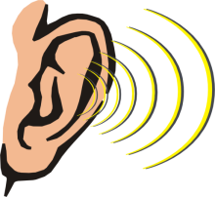
Frequency
Human hearing → 20 Hz – 20,000 Hz
Subsonic = below 20 Hz
Ex: wind, earthquakes
Ultrasonic = above 20,000 Hz
Ex: Sonar, echolocation, ultrasound

Slide 13
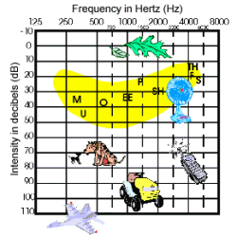
Intensity
Amount of energy of a sound
Measured in Decibels (dB)
Some sounds with high intensity may be considered noise.

Slide 14
Loud
Soft

Slide 15
Standing Wave
Standing waves appear not to move.

Slide 16
Let’s compare waves
Lower f Higher f
Higher λ Lower λ
Amplitude same

Slide 17
Let’s compare waves
Lower f Higher f
Higher λ Lower λ
Higher Amplitude Lower Amplitude

Slide 18
Let’s compare waves
Lower f Higher f
Higher λ Lower λ
Lower Amplitude Higher Amplitude

Slide 19
Let’s compare waves
Higher f Lower f
Lower λ Higher λ
Lower Amplitude Higher Amplitude

Slide 20
Which wave has the highest f?

Slide 21
Which wave has the highest amplitude?

Slide 22
Which wave has the lowest λ?

