Slide 1
SOUND
Energy in Waves

Slide 2
Sound is a form of energy
Sound travels as a wave
Wave = disturbance that transfers energy from place to place
Sound = disturbance, or vibration, that travels through a medium as a longitudinal wave.

Slide 3
Vibrations
= Back and forth movement of molecules of matter

Slide 4
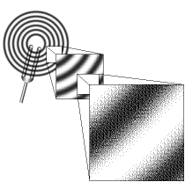
Requirements For Sound...
Source of vibration (such as vocal chords)
Source of energy (such as lungs)
A medium
(to carry the vibration,
such as air)
A receiver
(such as the human ear)

Slide 5
Medium
Medium = material which carries the sound wave
Examples:
water wave → medium = water
stadium wave → medium = _______________
sound wave → medium= ___________
crowd
air

Slide 6
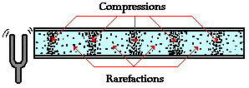
Sounds are waves of pressure
(in this case: moving through a gas → air)

Slide 7
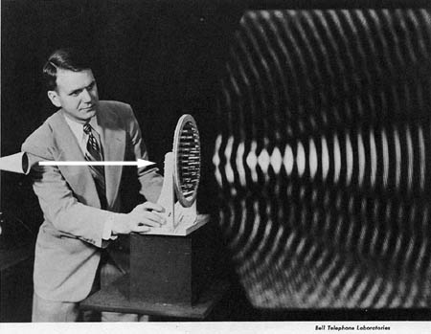
Sound Waves
Alternating areas of high & low pressure in the air
Sound waves move out in ALL directions from a vibrating object

Slide 8
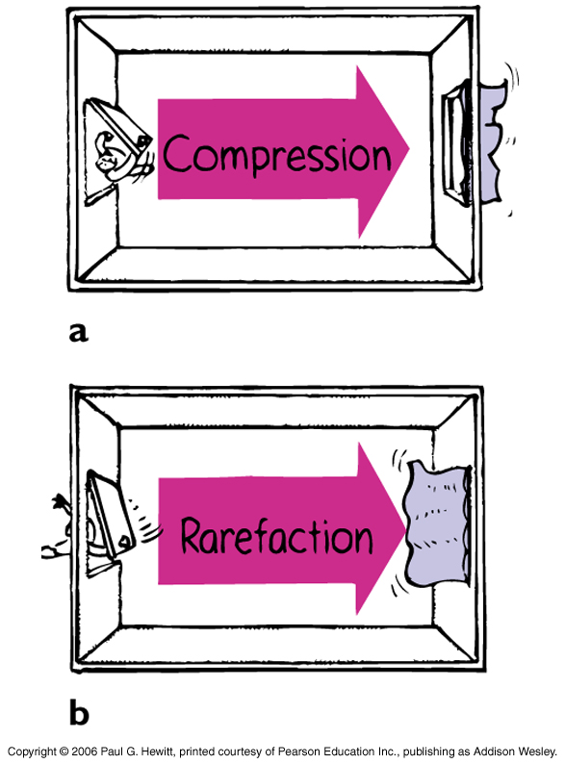
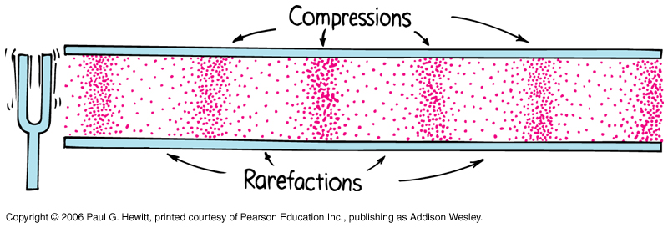
Compression and Rarefaction

Slide 9
Vibration (source)
Medium
Perception
(receiver)
Surface Vibration Pressure Wave Ear

Slide 10
Energy travels Air molecules do not travel Air molecules transfer the energy

Slide 11
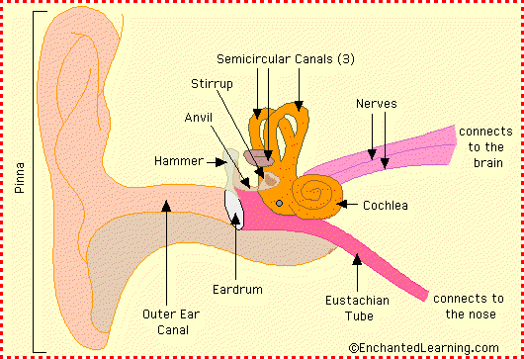
Eardrum is an elastic membrane that can vibrate

Slide 12
Sound travels more quickly through solids than liquids or gases
Speed of Sound increases with density of the medium
15,000 ft/sec in steel
4500 ft/sec in water
1100 ft/sec in air

Slide 13
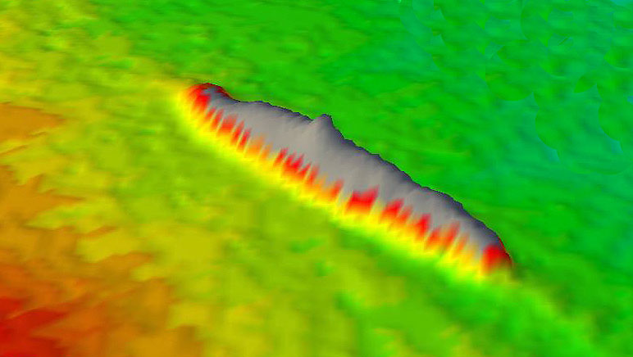
Sonar
An instrument that uses reflected sound waves to find underwater objects

Slide 14
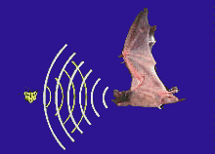
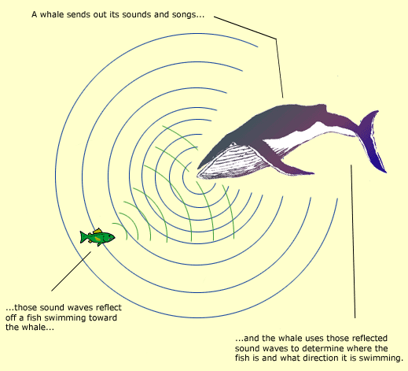
Sonar
An instrument that uses reflected sound waves to find underwater objects
Animals use sonar or echo location to find their prey; these sounds have such a high pitch or frequency that the human ear cannot hear

Slide 15
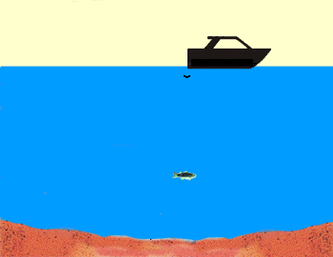
We use sonar to locate or map objects

Slide 16
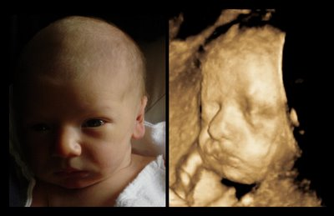

Slide 17
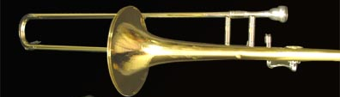
Sound and Instruments
Instruments can be played at different pitches by changing lengths of the column of air which changes the wavelength.

Slide 18
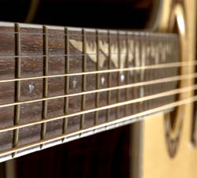
http://www.youtube.com/watch?v=h8gIDf_dEF4

Slide 19
High pitch
Short wavelength
Low pitch
Long wavelength

