Slide 1
Properties of Matter Unit 5 Notes (#43)

Slide 2
Matter is anything that has mass and volume
Everything is made of matter

Slide 3
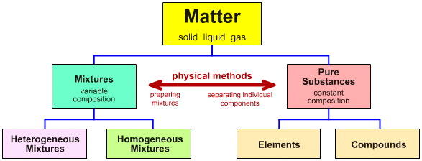

Slide 4
Elements – made up of 1 type of atom
ex: gold
Compounds – made up of more than 1 type of atom
ex: H₂O

Slide 5
What are properties?
= Characteristics used to describe an object.
Properties are used to identify a substance
Ex: color, shape, size, density, texture…

Slide 6
General Properties of matter:
mass
weight
volume
density

Slide 7
Mass
= amount of matter in an object

Slide 8
Weight
= Measure of force of gravity on the mass of an object
Weight changes with changes in gravity

Slide 9
Volume
= Measure of space taken up by an object.

Slide 10
Density
= Mass to Volume Ratio
water = 1.0 g/ml
Objects with densities greater than (>) 1.0 will sink in water

Slide 11
Density
= m
v

Slide 12
Calculations
If 96.5 grams of gold has a volume of 5 cubic centimeters (cm³), what is the density of gold?
G: m = 96.5 g V = 5 cm³
U: ρ = ?
E: ρ = m/v
S: ρ = 96.5g / 5cm³
S: ρ = 19.3 g/cm³

Slide 13
PROPERTIES

Slide 14
Physical properties
Physical properties are those that can be observed without changing the identity of the substance

Slide 15
Physical properties
color
smell
freezing/melting point
boiling point
density

Slide 16
Chemical properties
Chemical properties describe how a substance changes into a new substance

Slide 17
Chemical properties
flammability
pH
reactivity

Slide 18
CHANGES

Slide 19
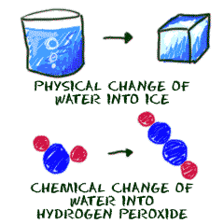

Slide 20
Physical Changes
Physical changes involve the changing of physical properties
Type of matter remains the same

Slide 21
Physical Changes
Changing shape
Changing texture
Changing hardness
Changing phase

Slide 22
Chemical Changes
The change of a substance into a new and different substance
Also known as a chemical reaction

Slide 23
Chemical Changes
Bubbling
Rusting
Cooking
Burning
Temperature change
Precipitate formed
New Odor
Color change

Slide 24
Chemical reaction
Bonds between atoms are formed or broken, and substances change into different substances with new and different properties

Slide 25
Mixture
= combination of 2 + substances
- each substances retains own properties
mix physically, not chemically
Ex: sand and sugar

Slide 26
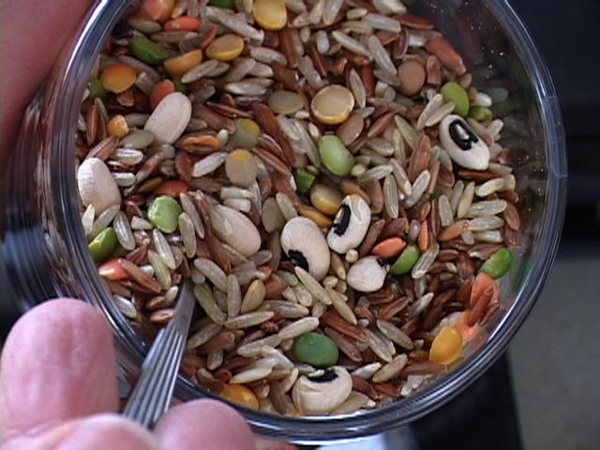
Mixtures
Heterogeneous = different materials can be easily distinguished
Ex: rocks and sand

Slide 27
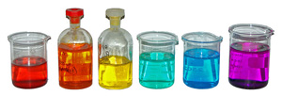
Mixtures
Homogeneous = appears the same throughout; different materials CANNOT be easily distinguished
Ex: salt water

Slide 28
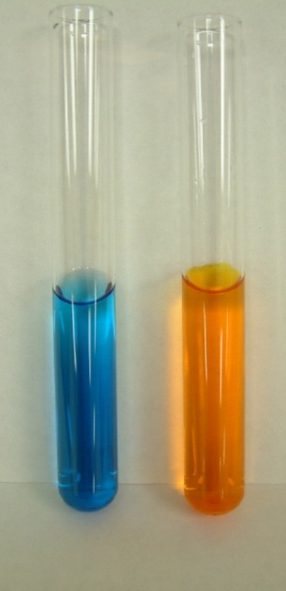
3 Types of Mixtures
Solution
- homogeneous mixture where substances are distributed evenly in another substance.
- i.e. dissolves
Ex: Kool-Aid mix and water

Slide 29
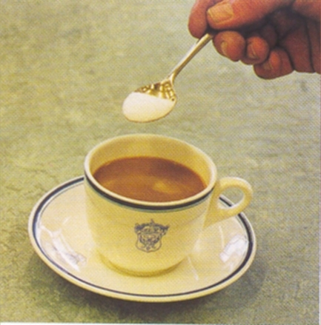
Parts for a Solution
1. Solute
- usually less
- gets dissolved
2. Solvent
- usually more
- does the dissolving
* water is the “universal” solvent

Slide 30
Suspensions
- particles do not stay
suspended.
- particles larger than 1000nm
Ex. Oil & vinegar
or
sand & water

Slide 31
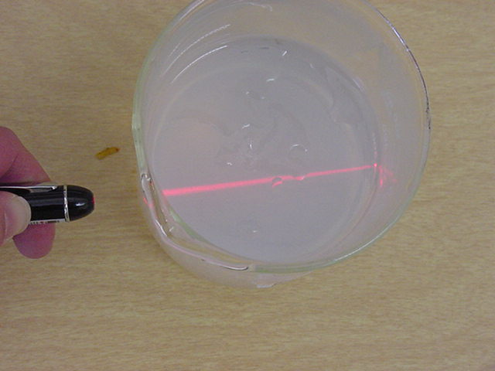
Colloids
- particles stay suspended
- not dissolved
Emulsion = liquid in liquid
Ex: mayo

Slide 32
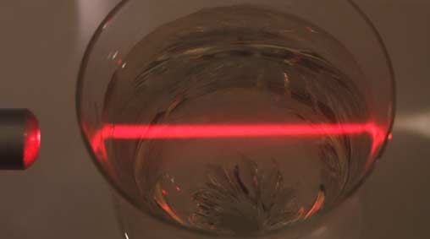
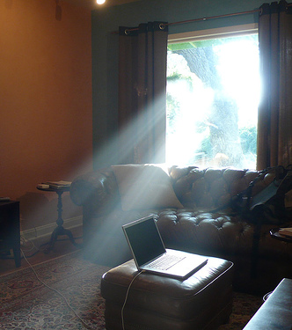
Tyndall Effect
- beam of light is passed through
a mixture
- beam can be seen because
particles are
big enough to
scatter light

